Slide 1





Slide 2
Introduction
Dataset contains State-wise testing details in India
Data for 2020 and 2021
~16k Records
Exploratory Data Analysis
Total Samples
Positive
Negative

Slide 3

Problem Statement
To analyze the trend of Covid cases across various states in India

Slide 4
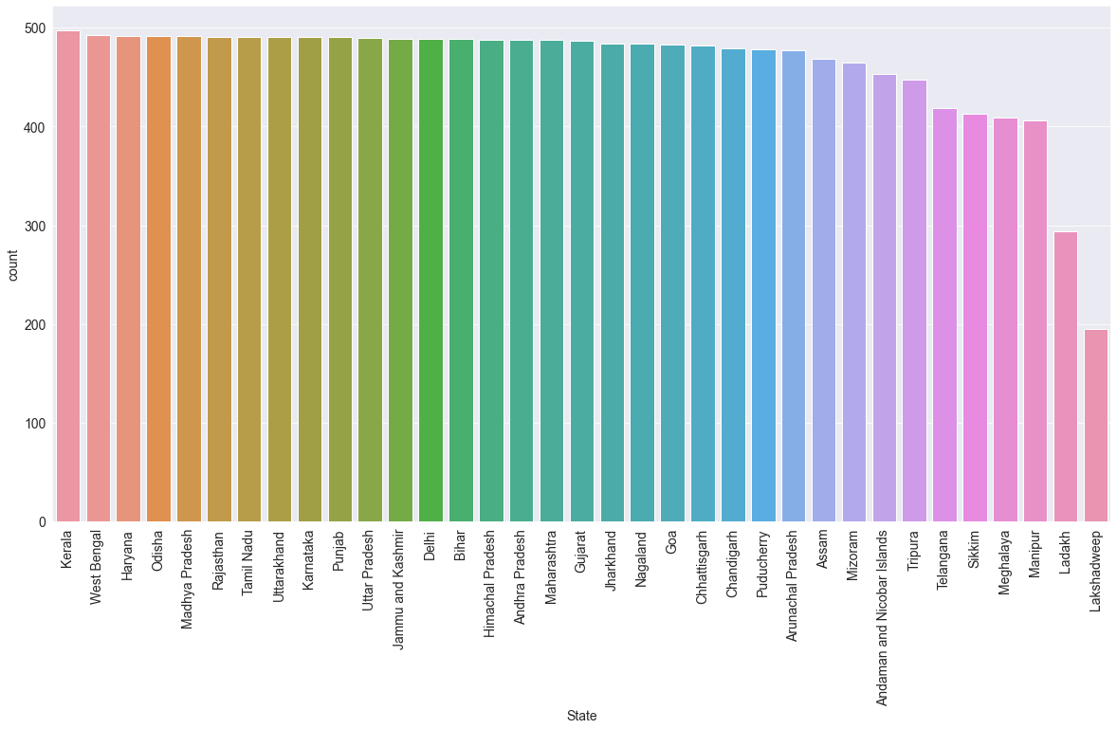
Kerala conducted tests maximum number of days

Slide 5
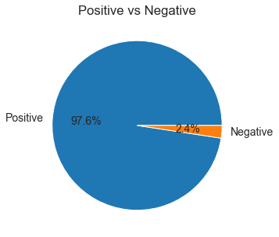
Among the total samples collected, around 97.6% cases turned out to be positive

Slide 6
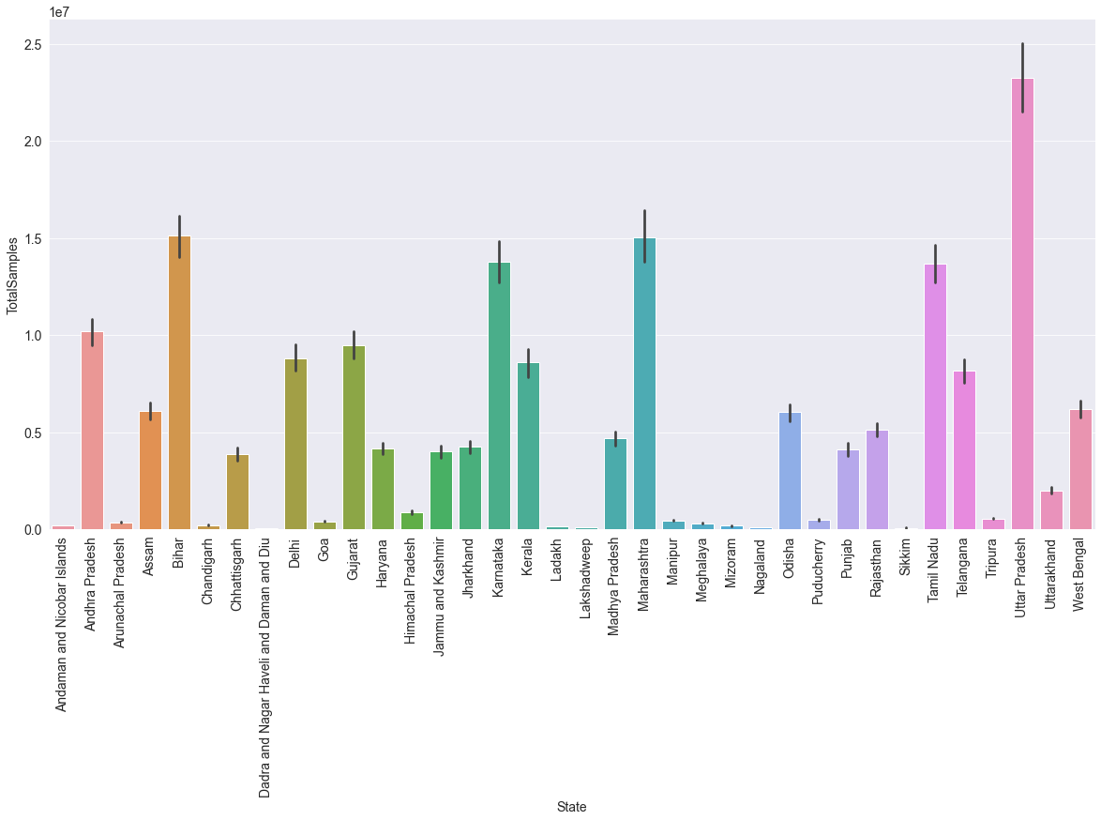
Uttar Pradesh collected maximum mumber of swab samples

Slide 7
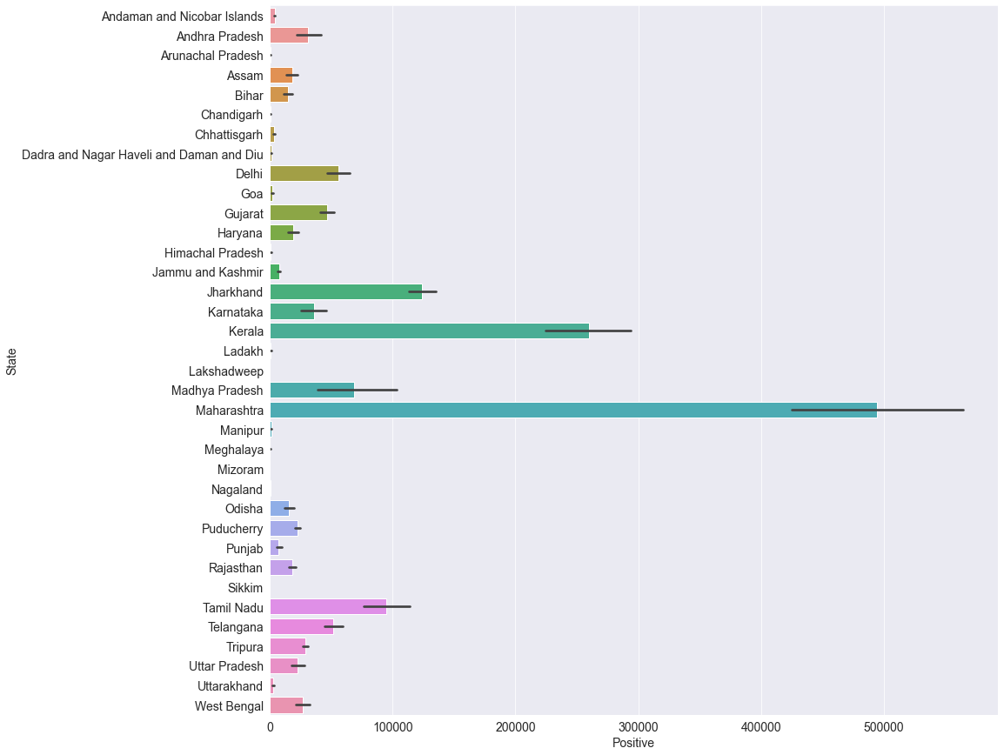
Maharashtra showed maximum number of postive cases

Slide 8
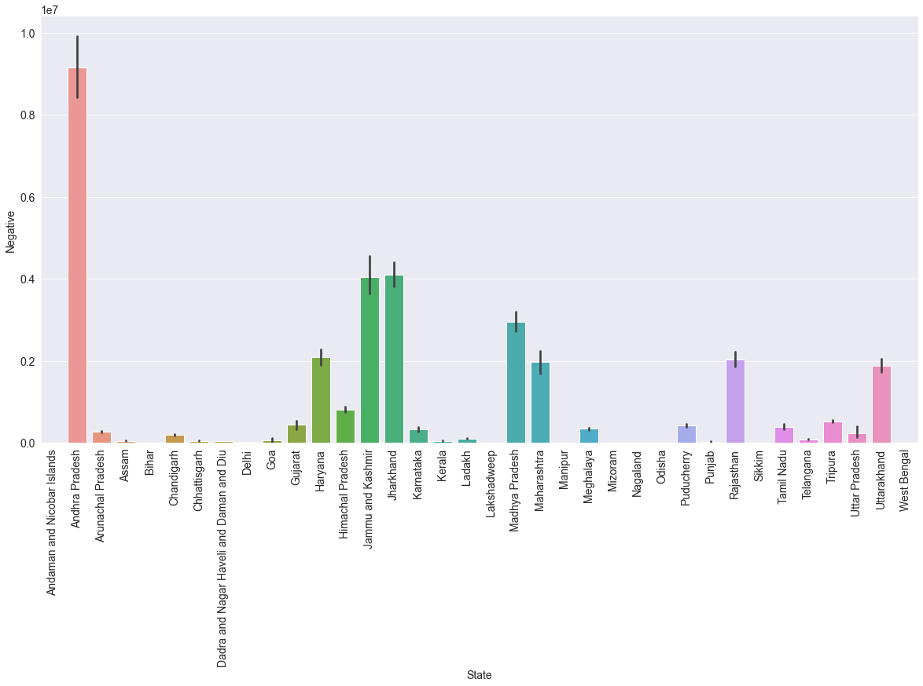
Andhra Pradesh showed increase in negative covid test results

Slide 9
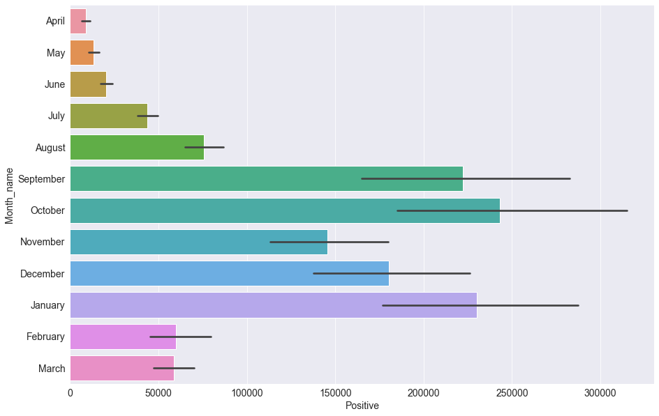
October and January months recorded the maximum number of positive cases in both the years

